Slide 1
CYCLIC CODES
Cyclic codes are special linear block codes with one extra property. In a cyclic code, if a codeword is cyclically shifted (rotated), the result is another codeword.
Topics discussed in this section:
Cyclic Redundancy Check Polynomials Cyclic Code Analysis

Slide 2
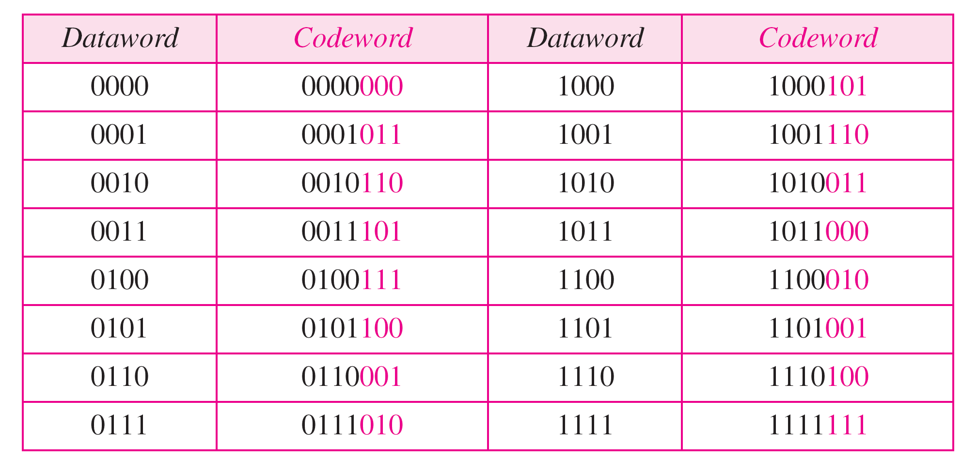
Table 10.6 A CRC code with C(7, 4)

Slide 3
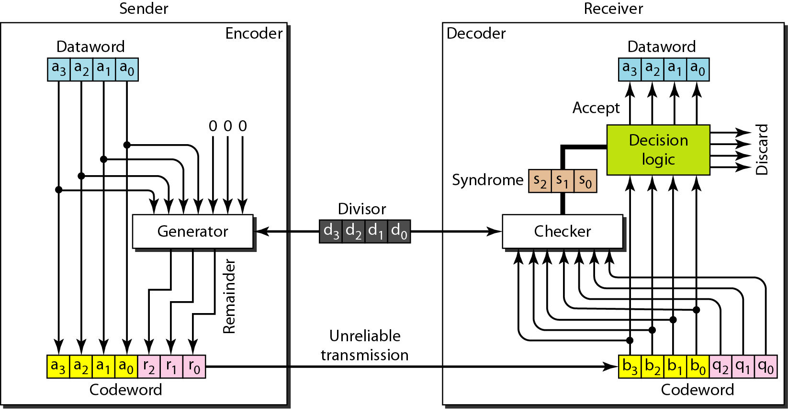
Figure 10.14 CRC encoder and decoder

Slide 4
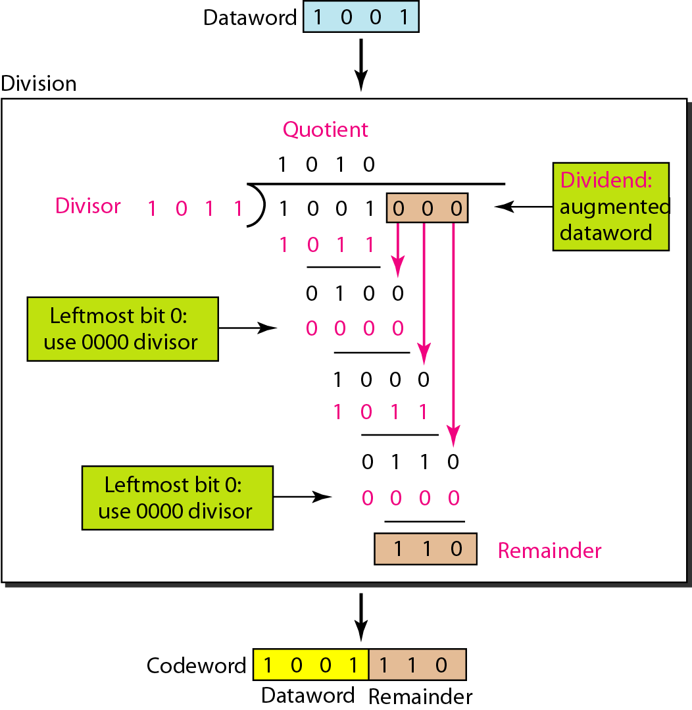
Figure 10.15 Division in CRC encoder

Slide 5
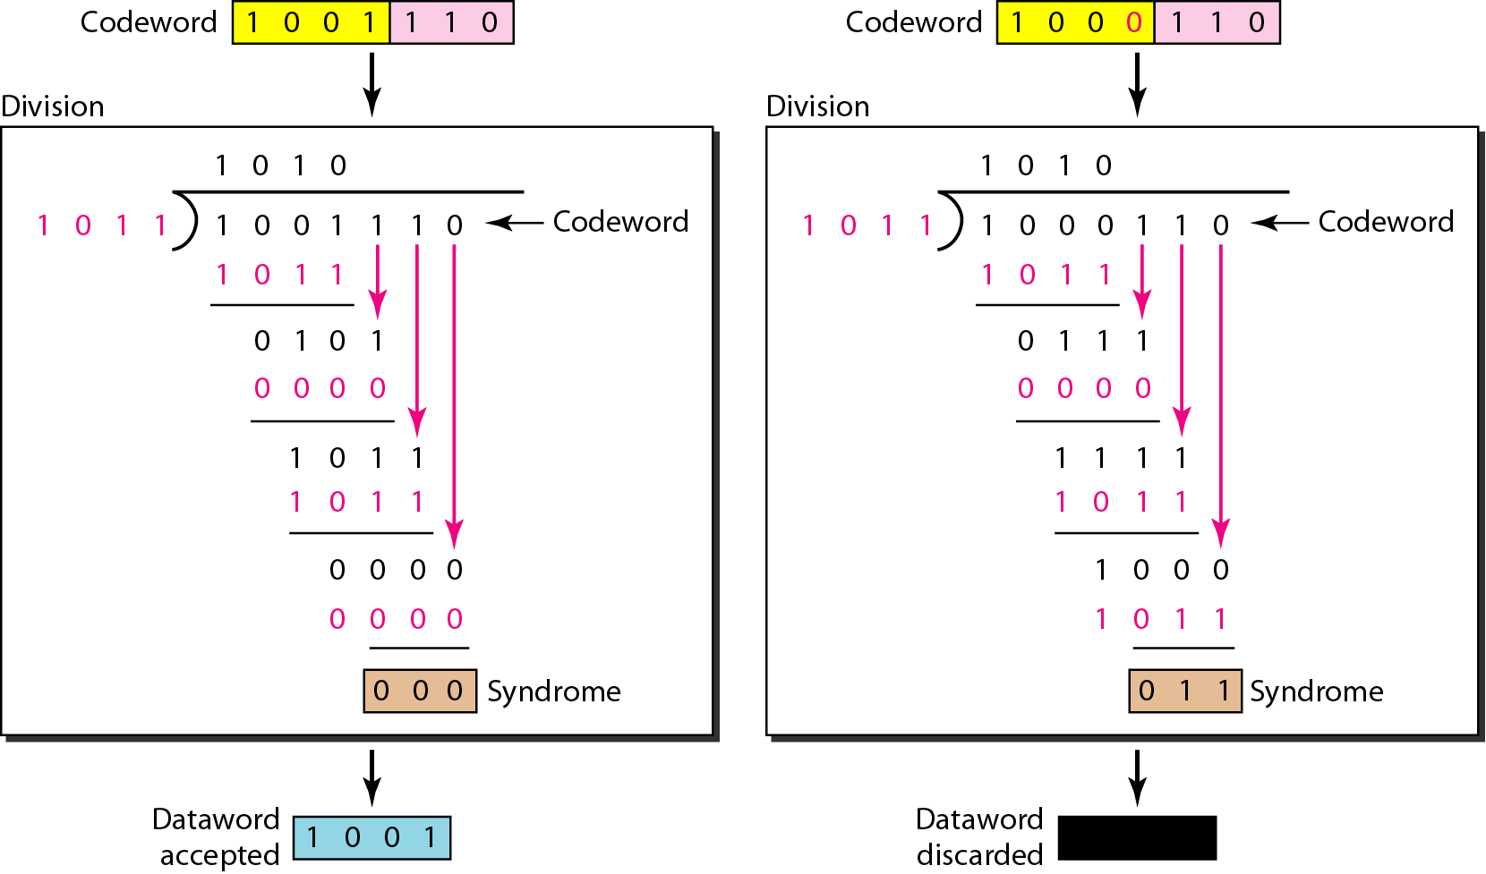
Figure 10.16 Division in the CRC decoder for two cases

Slide 6
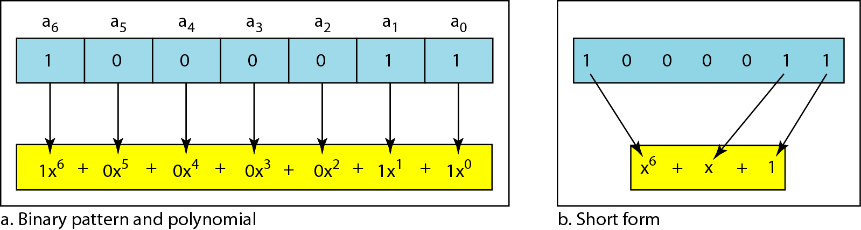
Figure 10.21 A polynomial to represent a binary word

Slide 7
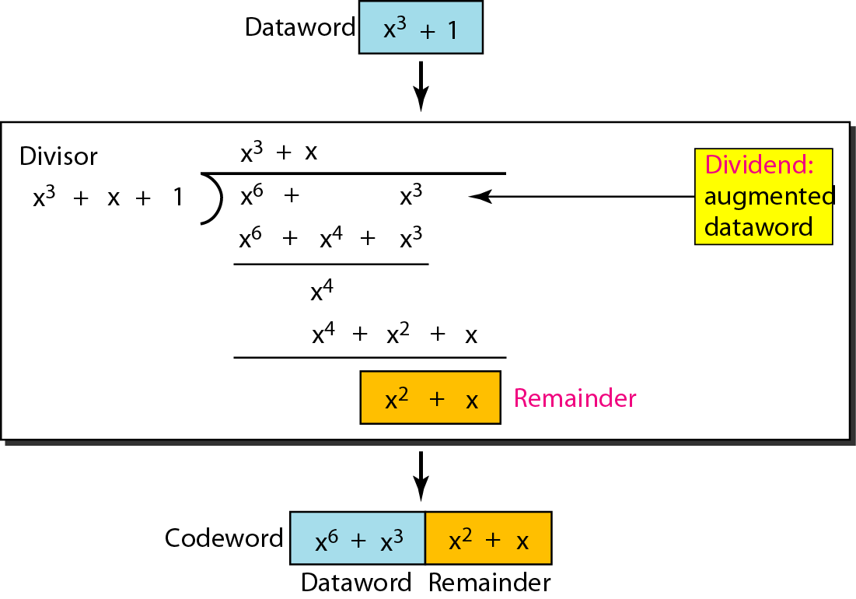
Figure 10.22 CRC division using polynomials

Slide 8

Note
The divisor in a cyclic code is normally called the generator polynomial
or simply the generator.

Slide 9
Note
In a cyclic code,
If s(x) ≠ 0, one or more bits is corrupted.
If s(x) = 0, either
a. No bit is corrupted. or
b. Some bits are corrupted, but the decoder failed to detect them.

Slide 10
Note
In a cyclic code, those e(x) errors that are divisible by g(x) are not caught.

Slide 11
Note
If the generator has more than one term and the coefficient of x⁰ is 1, all single errors can be caught.

Slide 12
Example 10.15
Which of the following g(x) values guarantees that a single-bit error is caught? For each case, what is the error that cannot be caught?
a. x + 1 b. x³ c. 1
Solution
a. No x^{i} can be divisible by x + 1. Any single-bit error can be caught.
b. If i is equal to or greater than 3, x^{i} is divisible by g(x). All single-bit errors in positions 1 to 3 are caught.
c. All values of i make x^{i} divisible by g(x). No single-bit error can be caught. This g(x) is useless.

Slide 13
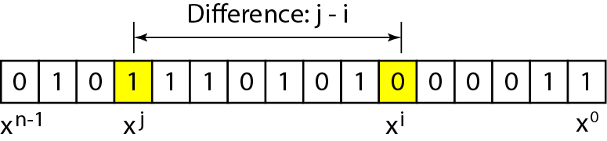
Figure 10.23 Representation of two isolated single-bit errors using polynomials

Slide 14
Note
If a generator cannot divide x^{t} + 1 (t between 0 and n – 1),
then all isolated double errors can be detected.

Slide 15
Example 10.16
Find the status of the following generators related to two isolated, single-bit errors.
a. x + 1 b. x⁴ + 1 c. x⁷ + x⁶ + 1
Solution
a. This is a very poor choice for a generator. Any two errors next to each other cannot be detected.
b. This generator cannot detect two errors that are four positions apart.
c. This is a good choice for this purpose.

Slide 16
Note
A generator that contains a factor of x + 1 can detect all odd-numbered errors.

Slide 17
Note
A good polynomial generator needs to have the following characteristics:
1. It should have at least two terms.
2. The coefficient of the term x⁰ should be 1.
3. It should not divide x^{t} + 1, for t between 2 and n − 1.
4. It should have the factor x + 1.

Slide 18
Table 10.7 Standard polynomials

Slide 19
CHECKSUM
The last error detection method we discuss here is called the checksum. The checksum is used in the Internet by several protocols although not at the data link layer.
Topics discussed in this section:
Idea One’s Complement Internet Checksum

Slide 20
Example 10.18
Suppose our data is a list of five 4-bit numbers that we want to send to a destination. In addition to sending these numbers, we send the sum of the numbers. For example, if the set of numbers is (7, 11, 12, 0, 6), we send (7, 11, 12, 0, 6, 36), where 36 is the sum of the original numbers. The receiver adds the five numbers and compares the result with the sum. If the two are the same, the receiver assumes no error, accepts the five numbers, and discards the sum. Otherwise, there is an error somewhere and the data are not accepted.

Slide 21
Example 10.19
We can make the job of the receiver easier if we send the negative (complement) of the sum, called the checksum. In this case, we send (7, 11, 12, 0, 6, −36). The receiver can add all the numbers received (including the checksum). If the result is 0, it assumes no error; otherwise, there is an error.

Slide 22
Example 10.20
How can we represent the number 21 in one’s complement arithmetic using only four bits?
Solution
The number 21 in binary is 10101 (it needs five bits). We can wrap the leftmost bit and add it to the four rightmost bits. We have (0101 + 1) = 0110 or 6.

Slide 23
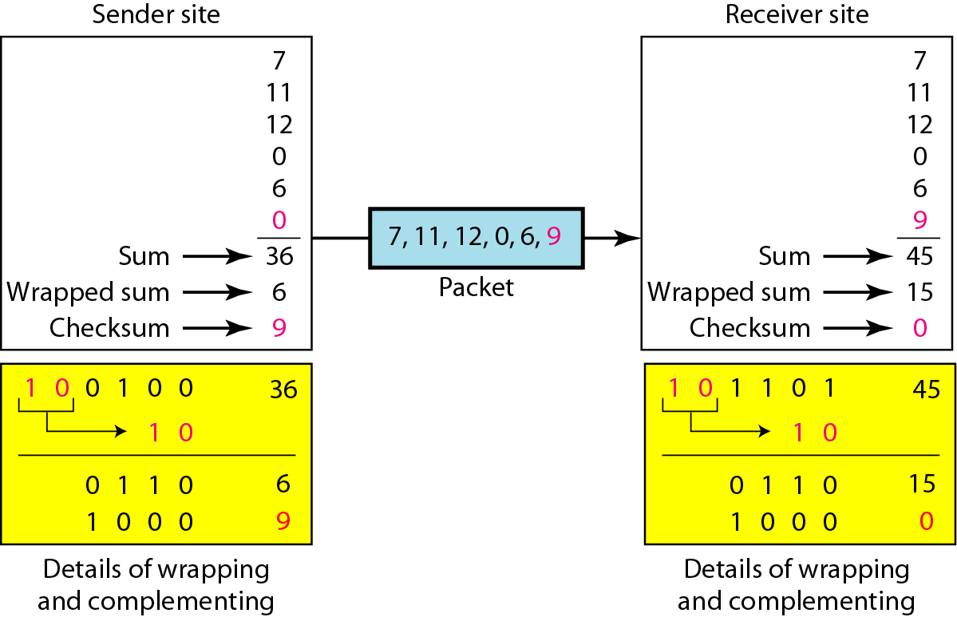
Figure 10.24 Example 10.22

Slide 24
Note
Sender site:
1. The message is divided into 16-bit words.
2. The value of the checksum word is set to 0.
3. All words including the checksum are added using one’s complement addition.
4. The sum is complemented and becomes the checksum.
5. The checksum is sent with the data.

Slide 25
Note
Receiver site:
1. The message (including checksum) is divided into 16-bit words.
2. All words are added using one’s complement addition.
3. The sum is complemented and becomes the new checksum.
4. If the value of checksum is 0, the message is accepted; otherwise, it is rejected.

Slide 26
Example 10.23
Let us calculate the checksum for a text of 8 characters (“Forouzan”). The text needs to be divided into 2-byte (16-bit) words. We use ASCII (see Appendix A) to change each byte to a 2-digit hexadecimal number. For example, F is represented as 0x46 and o is represented as 0x6F. Figure 10.25 shows how the checksum is calculated at the sender and receiver sites. In part a of the figure, the value of partial sum for the first column is 0x36. We keep the rightmost digit (6) and insert the leftmost digit (3) as the carry in the second column. The process is repeated for each column. Note that if there is any corruption, the checksum recalculated by the receiver is not all 0s. We leave this an exercise.

Slide 27
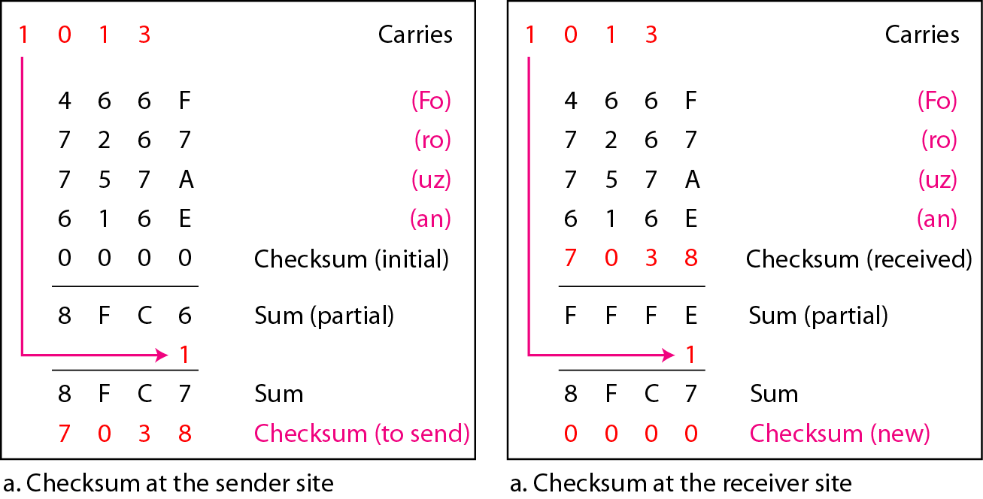
Figure 10.25 Example 10.23

